Slide 1

Eclipse IDE
Cheat Sheet
Beginner’s guide on navigating through Eclipse
By Alizah Saqib and Deb Harding

Slide 2
Contents
Eclipse IDE
Create Project
Create Class and Java File
Navigating Java Perspective
Edit, Run and Compile
Errors
Warnings
Perspective and Views
Formatter Profile Set Up
Auto-Format Save
Change Themes, Colors Fonts
Debug - Set Breakpoints
Debug - Start Debug Session
Debug - Step Through Code
Keyboard Short Cuts
More Support

Slide 3
Eclipse IDE
Different IDEs can be used for different languages and use cases. 10 Best Java IDE For Developers in 2025 - GeeksforGeeks
Why and IDE?
Makes coding easier and faster
Helps you avoid mistakes
Organizes your project files in one place
Gives you immediate feedback while you work
Why Eclipse?
Free & Reliable — No cost, works across Windows, macOS, and Linux.
Industry-Standard Tool — Still widely used in Java development.
Java-Focused Features — Offers auto-completion, auto-formatting, debugging, and more to make coding smoother.
Real-World Learning — Helps you practice organization, testing, and debugging in a professional environment.
Steps to Setup Eclipse on Windows or Mac OS

Slide 4
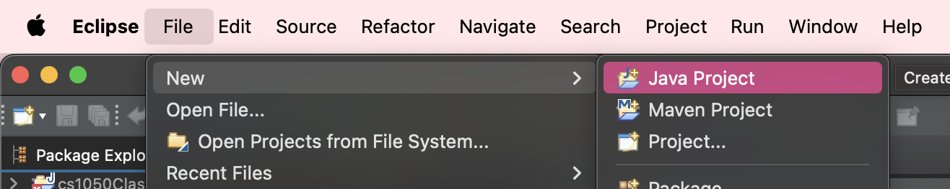
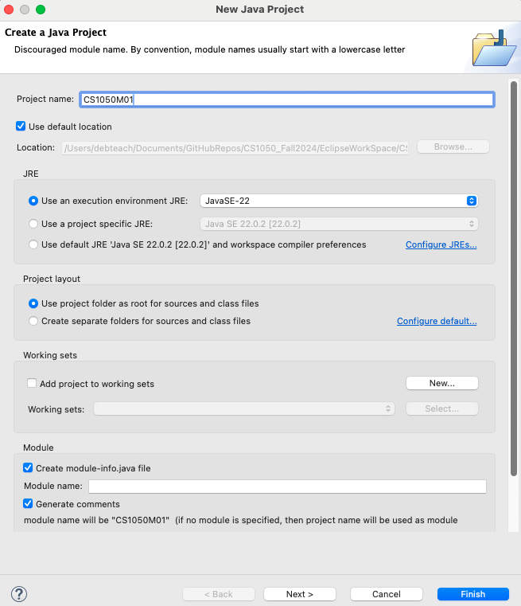
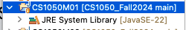
Create Project
Step 1
Start a new project click file > new > java project
Enter a name for your project (e.g., cs1050M01)
Configure settings -
Checkmark “Use default location” which should be your workspace folder in your git repository
“Use an execution environment JRE” should have your JavaSE (e.g. “JavaSE-22”)
Project layout: checkmark “use project folder as root for sources and class files”
Module: checkmark “Create-module-info.java file” and “Generate comments”
Click “finish” to create the project
Check to make sure the project is in the explorer window on the left and has JRE in it as shown
Step 2
This should be JavaSE but use version you set up.
Step 3a
Step 3b
Step 3c
Step 3d
Step 5
This creates a project folder to organize your java files
Step 4

Slide 5
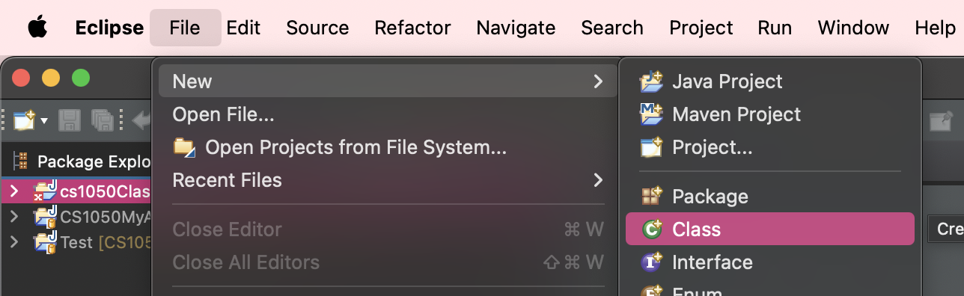
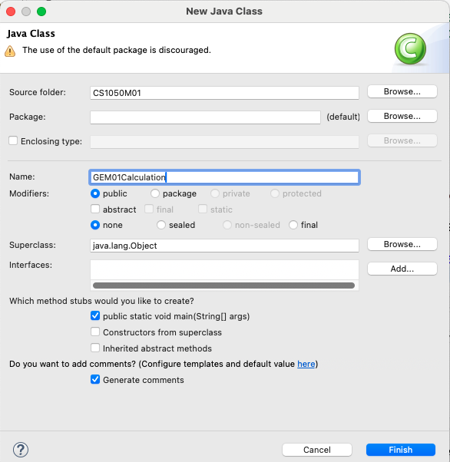
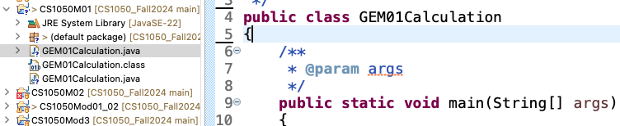
Create Class & Java File
Select the project folder you want to create it in - in the package explorer on the left, click on your project to highlight it
Create a new class - click file > new > class
Configure settings -
Source folder should be set, if not, select the project folder you want it to go in
Package should be empty, if not, delete the package
Enter a name for your class (e.g., GEM01Calculation)
Modifiers: checkmark “public”
Method stubs: checkmark “public static void main(String[] args)
Comments: checkmark “generate comments”
Click finish to create the class
This create your java file with class and main method
Step 1
Step 2
Step 3a
Step 3b
Step 3c
Step 3d
Step 3e
Step 3f
Step 5
Step 4

Slide 6
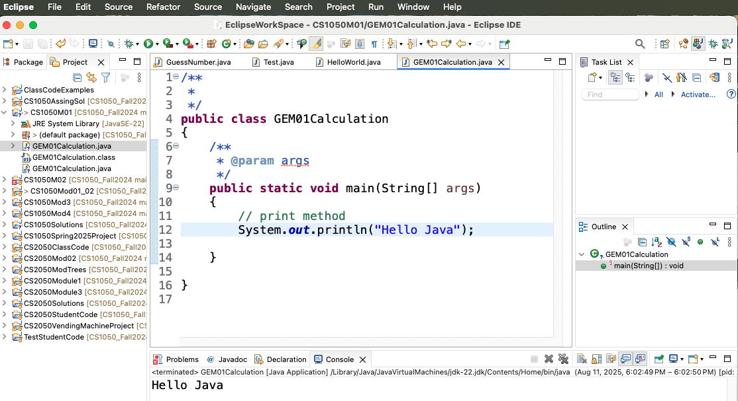
Navigating Java Perspective
Running your code
Run Program
Menus
Toolbar
Project Explore
Project Folders
Edit code
Project contain JRE System and java files
Console Tab
Console display

Slide 7
Edit, Run and Compile
When you click Run (▶) in Eclipse, two things happen:
Save & Compile – Eclipse automatically saves your changes and compiles your .java source files into .class files (Java bytecode).
Run on the JVM – The compiled .class files are then executed by the Java Virtual Machine (JVM).
Compilation checks your code for syntax errors and turns it into a format the JVM can understand. If there are errors, Eclipse won’t run the program until they’re fixed.
Warnings don’t stop compilation, but they should still be fixed to avoid future problems.
Editing Code:
You can change your code anytime in the editor.
When you run the program again, Eclipse automatically recompiles the changed files.
You don’t have to manually compile in most cases—Eclipse handles it for you.

Slide 8
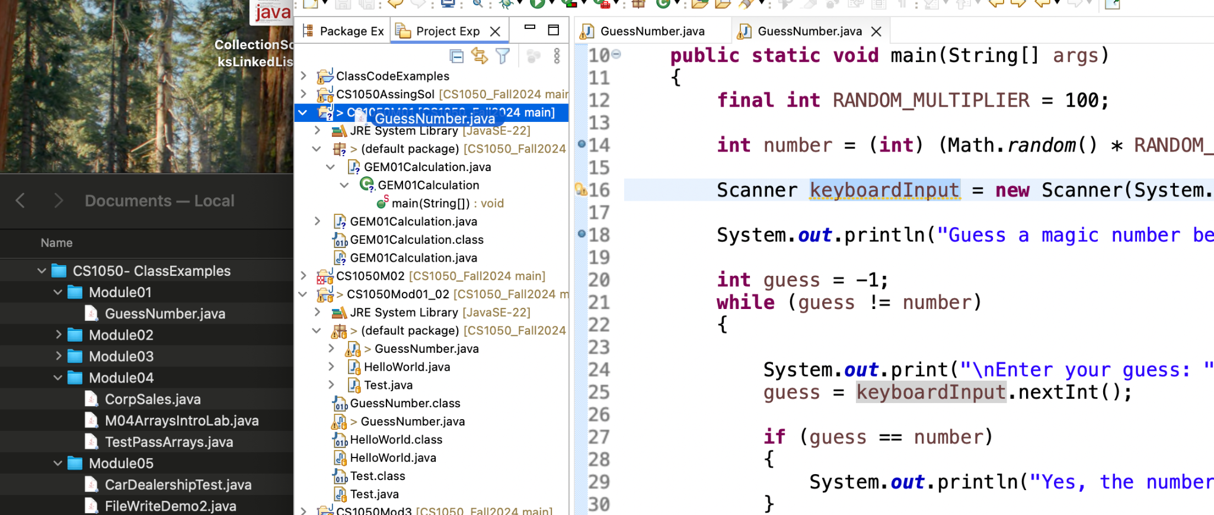
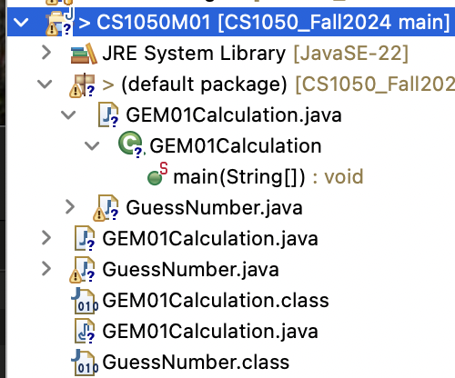
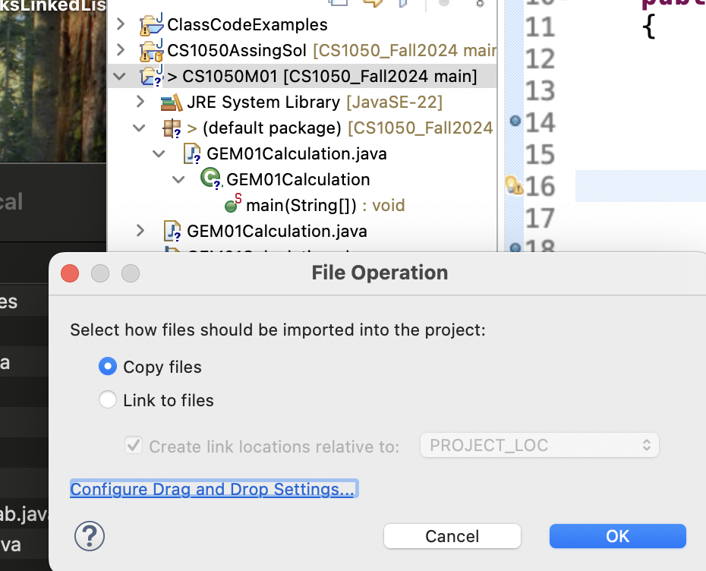
Add Existing Java File with Drag and Drop
You can add an existing Java file to a current project.
You should see the .java and .class file in the project. If you go to your github desktop you can commit and push a new version.
1. Make folder window and Eclipse window so you can drag java file into project folder
2. Click copy files so it will put the file in your repo workspace folder for versioning.

Slide 9
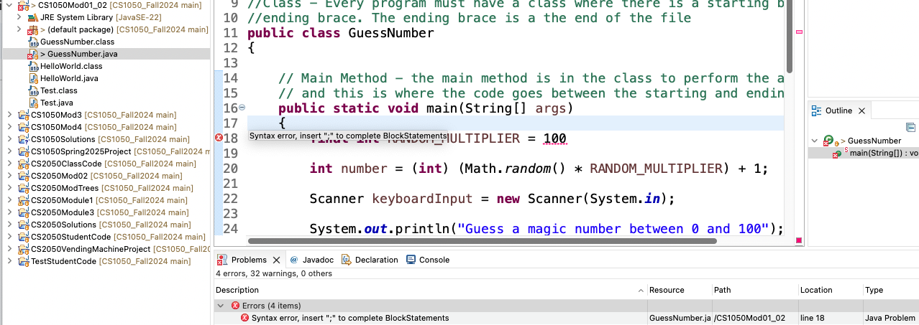
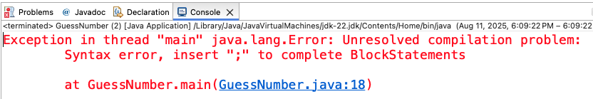
Errors
Error
Error Location - hover over for information on how to fix.
Problem
Problems Tab
Shows errors from all files.
Error Information
Description
File name
Line Number
Console Tab
Program won’t run and displays error in Console window

Slide 10
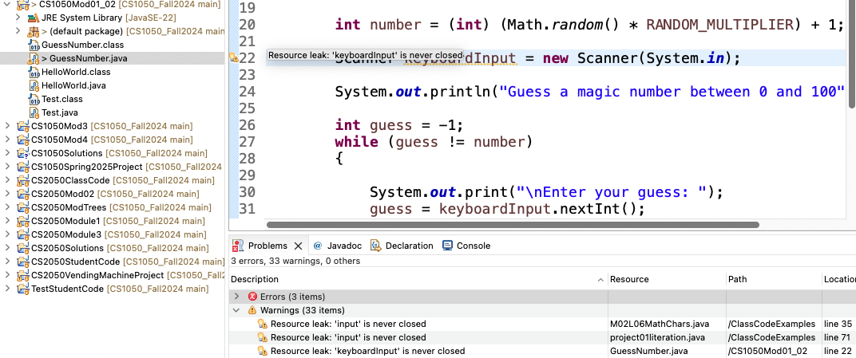
Warnings
Your program should not contain warnings. Why fix them?
Possible Security Risks – Some warnings indicate unsafe code that could be exploited.
Maintainability – Clean code is easier for you (and others) to read, debug, and improve.
Professional Standards – In industry, code reviews often require zero warnings before approval.
Prevent Future Bugs – Warnings can signal logic issues or outdated methods that might cause errors later.
warning
Problem
Warning Location - hover over for information on how to fix.
Problems Tab
Shows warnings from all files
Warning Information
Description
File name
Line Number

Slide 11
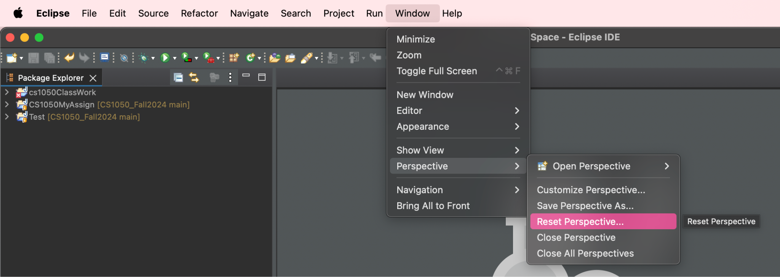
Perspective and Views
A “perspective” is just a layout of views and controls what you see in certain menus and toolbar. You will be using the Java and Debug Perspectives
If your “perspective” gets messed up Click window > perspective > reset perspective
If you accidentally close a panel and want to bring it back
If important windows like the console or package explorer disappear
Step 1

Slide 12
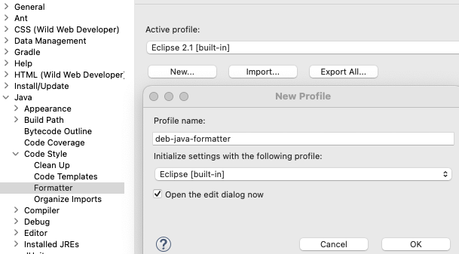
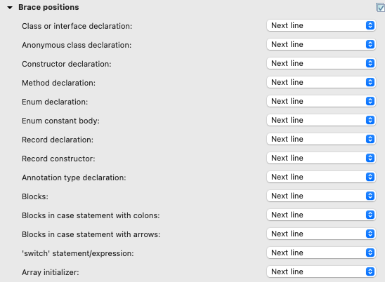
Formatter Profile Set Up
Go to the Braces section, for all categories set Position to Next line.
Click ok to save profile.
Click apply and save
Go to settings (or might be called preferences)
Windows OS Go to menus Window -> preferences
Mac OS go to menus Eclipse -> settings
Then navigate to Java -> Code Style -> Format
Click new, Give your profile a name and click ok
4
Step 3
Step 3
Step 2
Step 3
This helps find error when brace is missing or incorrectly placed.

Slide 13
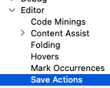
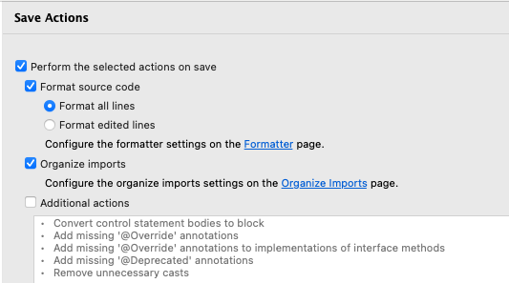
Auto-Format on Save
Save Actions on, running code will always auto-format since Eclipse saves before compiling.
Go to
Mac: Eclipse → Settings → Java → Editor → Save Actions
Windows: Window → Preferences → Java → Editor → Save Actions
Select these save actions
Step 1
Step 2
Type a messy block of code, then click Run — you should see the the correct format.

Slide 14
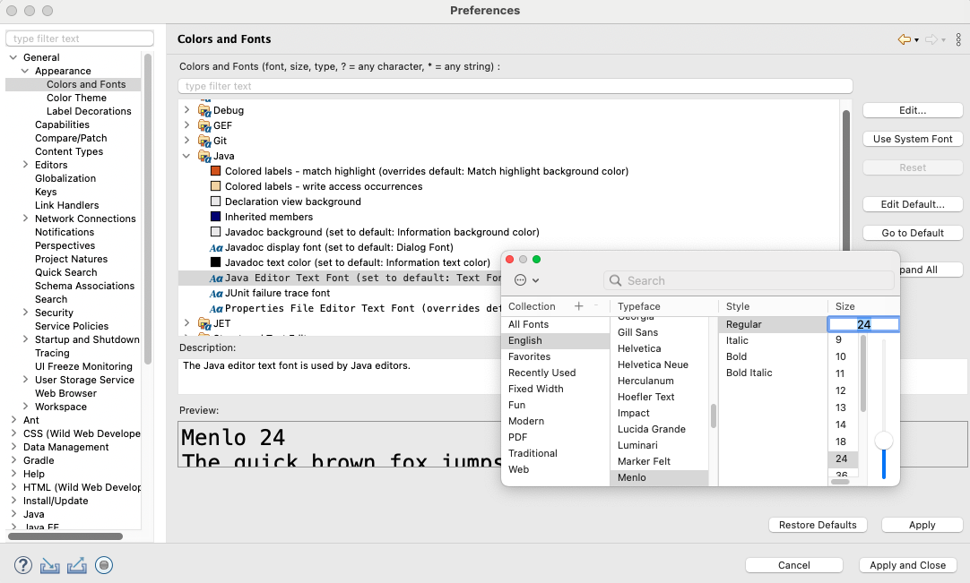
Change Themes, Colors Fonts
6 Best Fonts for Coding to Keep Your Eyes from Eyestrain | by plabs.id
If you want change the defaults go to Settings/Preferences general-> Appearance ->
Colors and Fonts:
Color Theme
Edit
For example, you can edit the font and size for the text editor
Make changes
Apply and your editor will reopen with changes applied..

Slide 15
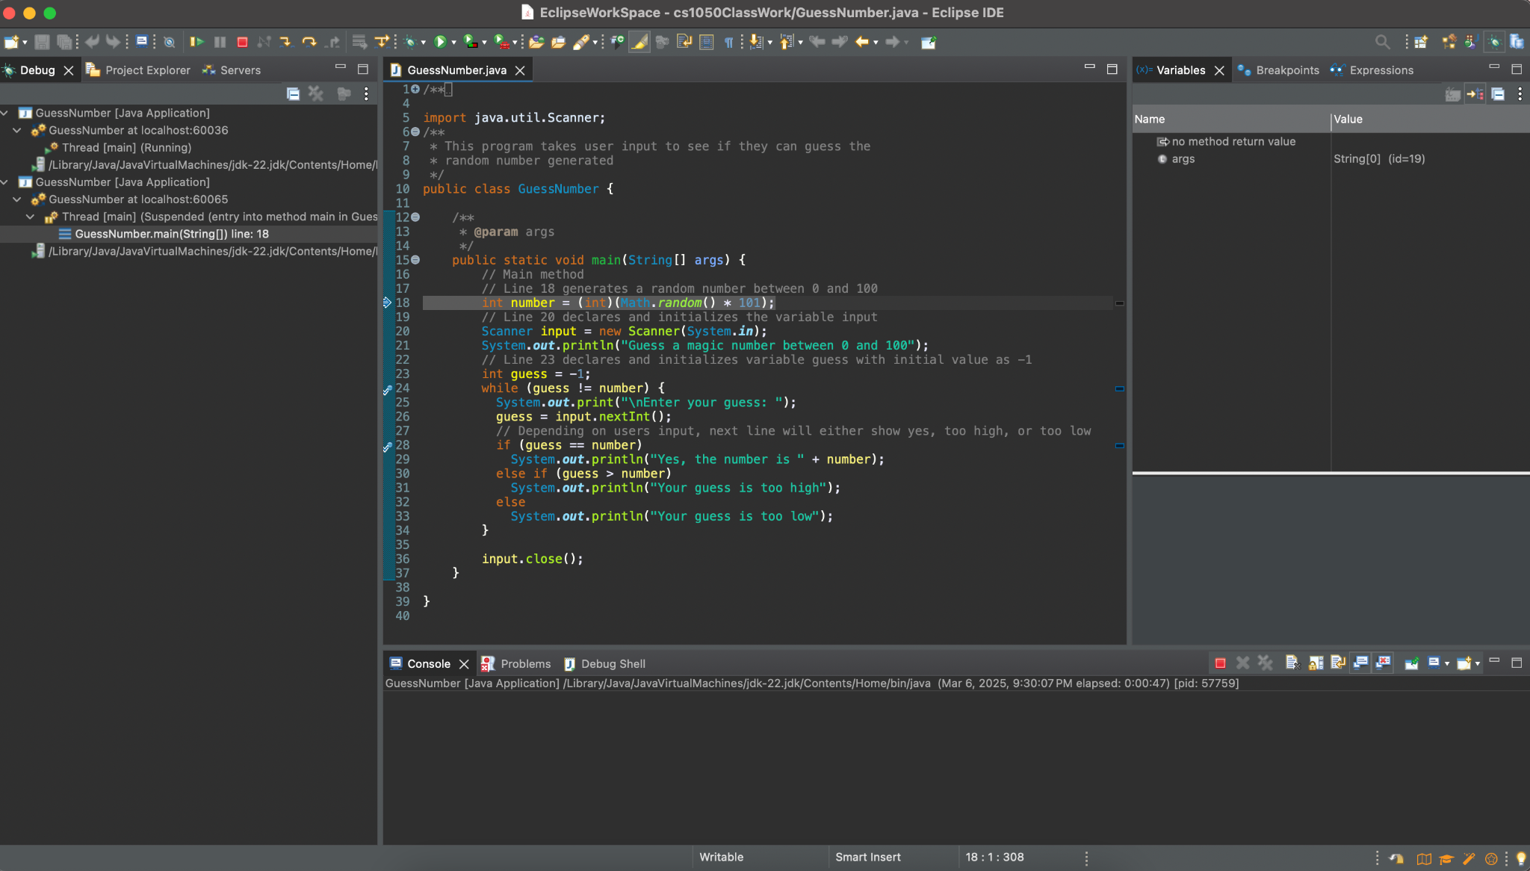

Debug - Set Breakpoints
Set Breakpoints to step through each statement and see what is stored in each variables memory
To set a breakpoint, double click directly to the left of the line numbers
A blue circle will appear next to the line, indicating that a breakpoint has been set
To get rid of the breakpoint, double-click on it and the blue dot will disappear
Breakpoint
Breakpoint

Slide 16
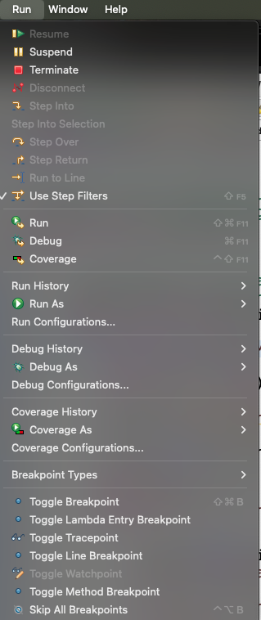
Debug: Start Debugging Session
To start a debugging session click the debug icon (a green bug) in the toolbar before the run button. You should see the variables window (Debug Perspective). If you don’t this could be because
You didn’t create your code in a project
The java code has syntax errors
Variables window
Debug window
If the program didn’t stop you may not have set breakpoints or it is skipping breakpoints. Make sure Skip All Breakpoints is not turned on in Run menu.
Console output
Do not select Skip All Breakpoints

Slide 17
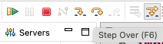
Debug: Step Through Code
Use the “step over” button to control the flow of the program and move through each line manually.
Menus
The pointer tells us which line is to be executed next in the code
Variables window - use this to track variable values and how they do or don’t update when a line of code executes
Console output - it’s important to track what is being printed to the console including print statements and error messages

Slide 18
Keyboard Shortcuts
Action | Mac | Windows
Run Program | ⌘ + F11 | Ctrl + F11
Debug Program | F11 | F11
Format Code | ⌘ + ⇧ + F | Ctrl + Shift + F
Organize Imports | ⌘ + ⇧ + O | Ctrl + Shift + O
Search / Find | ⌘ + F | Ctrl + F
Find in Project | ⌘ + H | Ctrl + H
Open Type (Class) | ⌘ + ⇧ + T | Ctrl + Shift + T
Open Resource (File) | ⌘ + ⇧ + R | Ctrl + Shift + R
Rename Variable/Method/Class | Alt + ⌘ + R | Alt + Shift + R
Switch Tabs | ⌘ + Option + → / ← | Ctrl + PageDown / PageUp
Close Tab | ⌘ + W | Ctrl + W
Undo | ⌘ + Z | Ctrl + Z
Redo | ⌘ + ⇧ + Z | Ctrl + Y

Slide 19
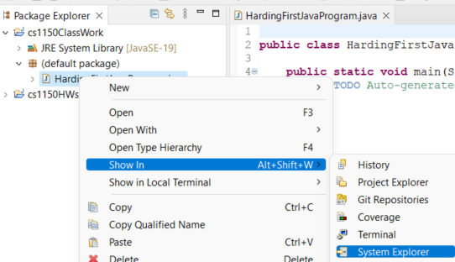
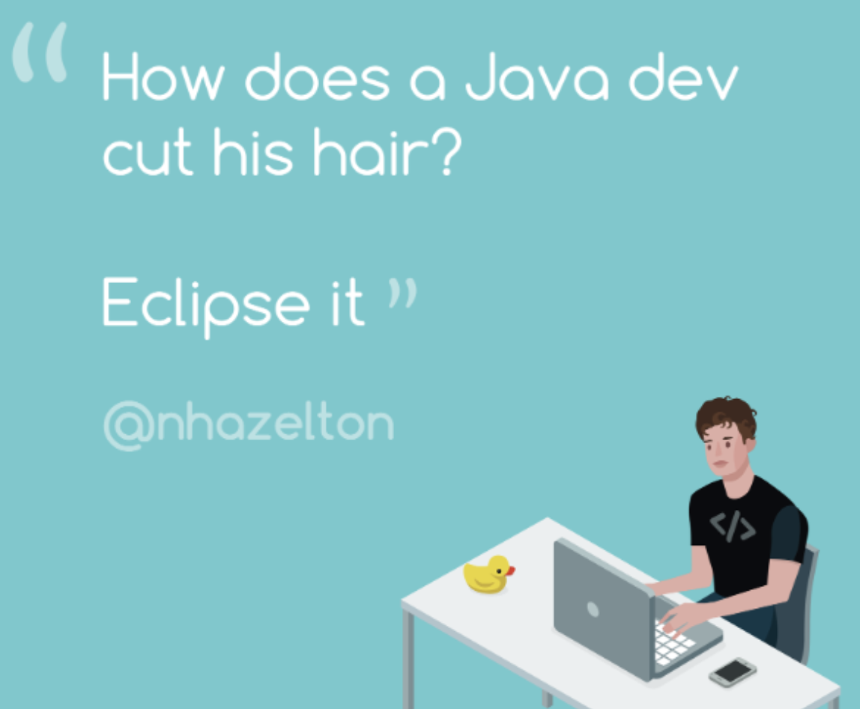
More Support
You can navigate to the file in your system explorer
right click the file then go to Show In -> System Explorer
More Eclipse Resources
Java Debugging with Eclipse - Tutorial
Eclipse Help

